Slide 1


QUIZ:
Can you tell what belongs on iNaturalist and what doesn’t?

Slide 2
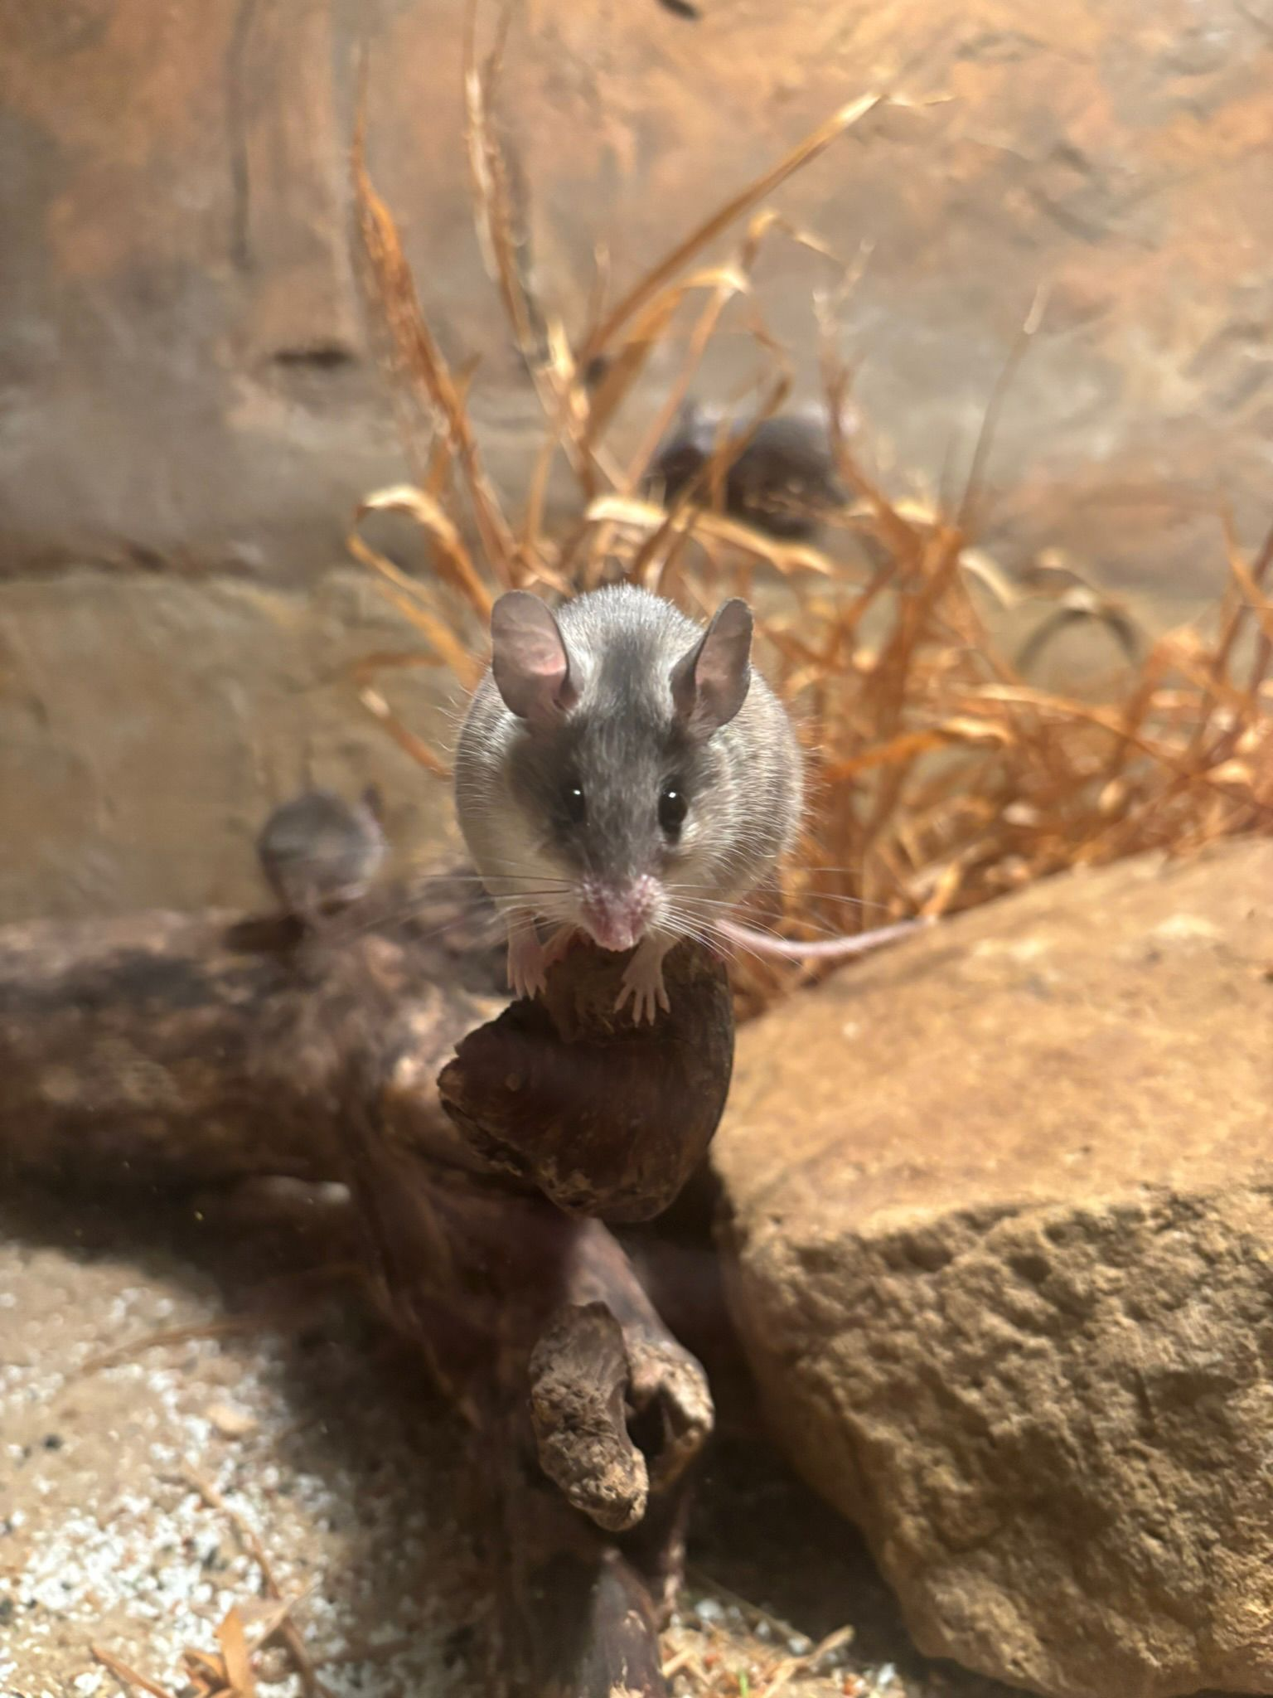


1.
iNat
iNot

Slide 3
1.
iNot
It is an animal from a ZOO, so it doesn‘t belong on iNaturalist.

Slide 4
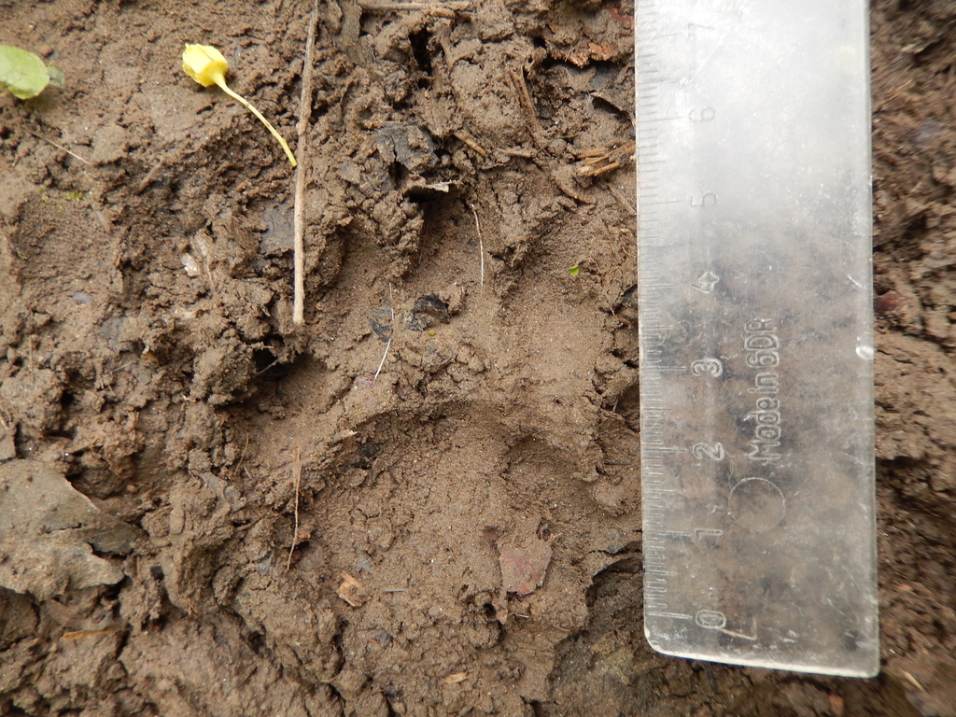
2.
iNat
iNot

Slide 5
2.
iNat
It is a European Badger track, so it belongs on iNaturalist.

Slide 6
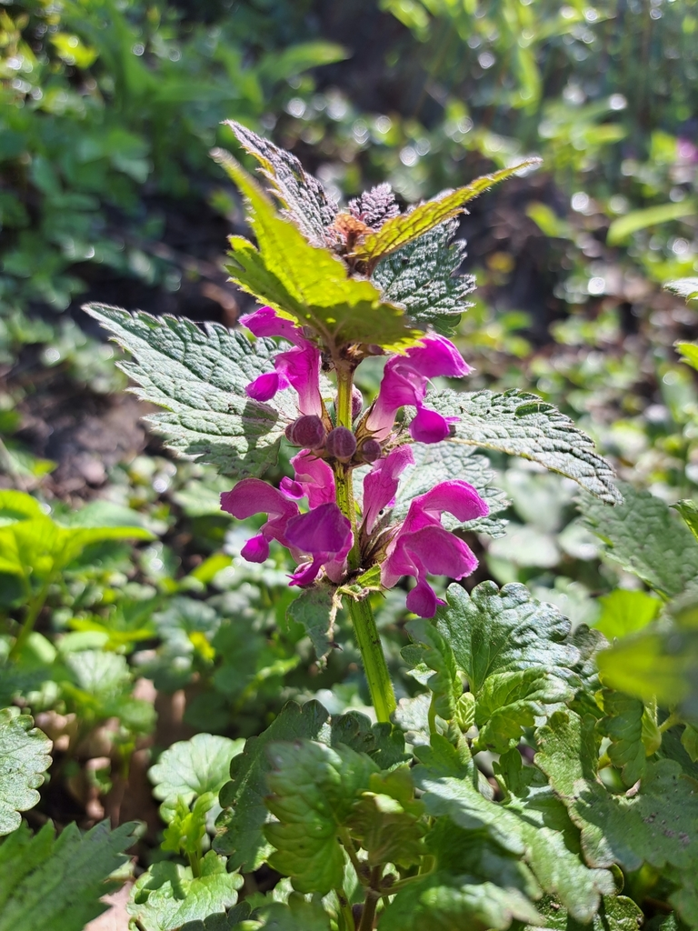
3.
iNat
iNot

Slide 7
3.
iNat
It is a Spotted Dead-nettle growing in the wild, so it belongs on iNaturalist. The photo clearly shows the floral tubes (curved into an S-shape), which are essential for correct identification.

Slide 8
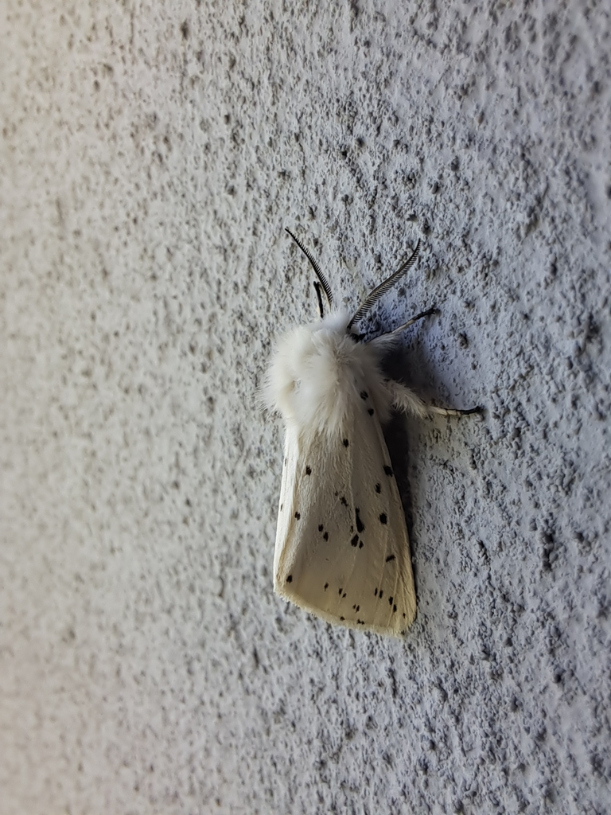
4.
iNat
iNot

Slide 9
4.
iNat
It is a wild White Ermine, so it belongs on iNaturalist. Identification is possible because the photo is close-up and well-focused.

Slide 10
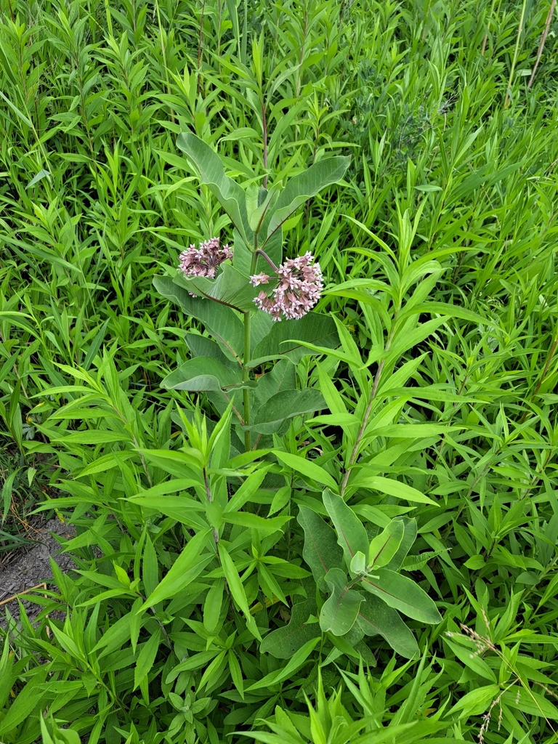
5.
iNat
iNot

Slide 11
5.
iNat
It is a species from North America, the Common Milkweed. Although it is a non-native species with invasive potential here, its occurrence needs to be monitored, so it belongs on iNaturalist.

Slide 12
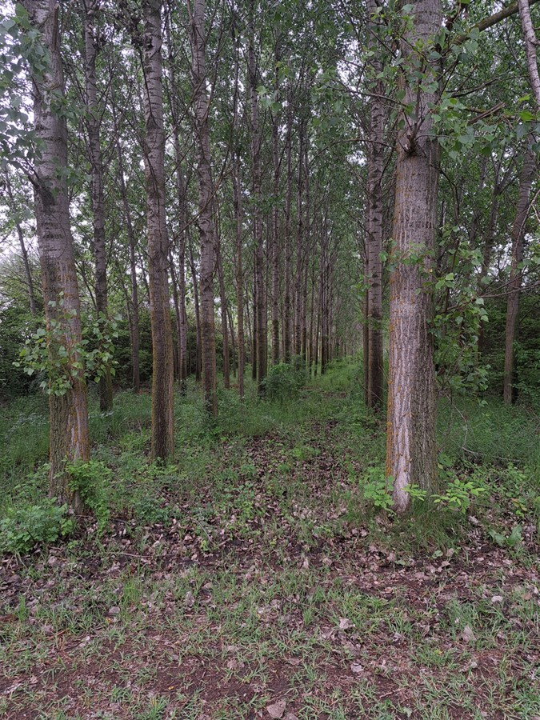
6.
iNat
iNot

Slide 13
6.
iNot
It is a monoculture of non-native poplar planted by humans for fast-growing timber, so it doesn‘t belong on iNaturalist.

Slide 14
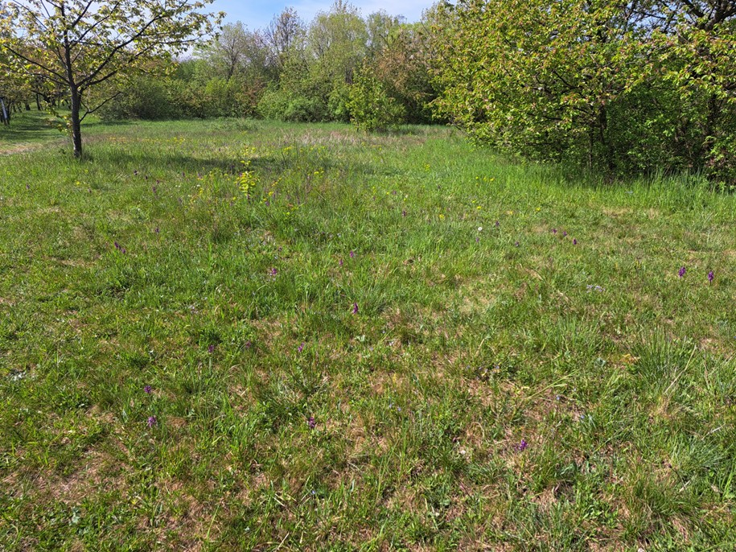
7.
iNat
iNot

Slide 15
7.
iNot
From the photo, it is impossible to tell which species the author intended to photograph. Even if there were something somewhat visible, it could not be identified correctly, so it doesn‘t belong on iNaturalist (unless it is a supplementary photo of the habitat).

Slide 16
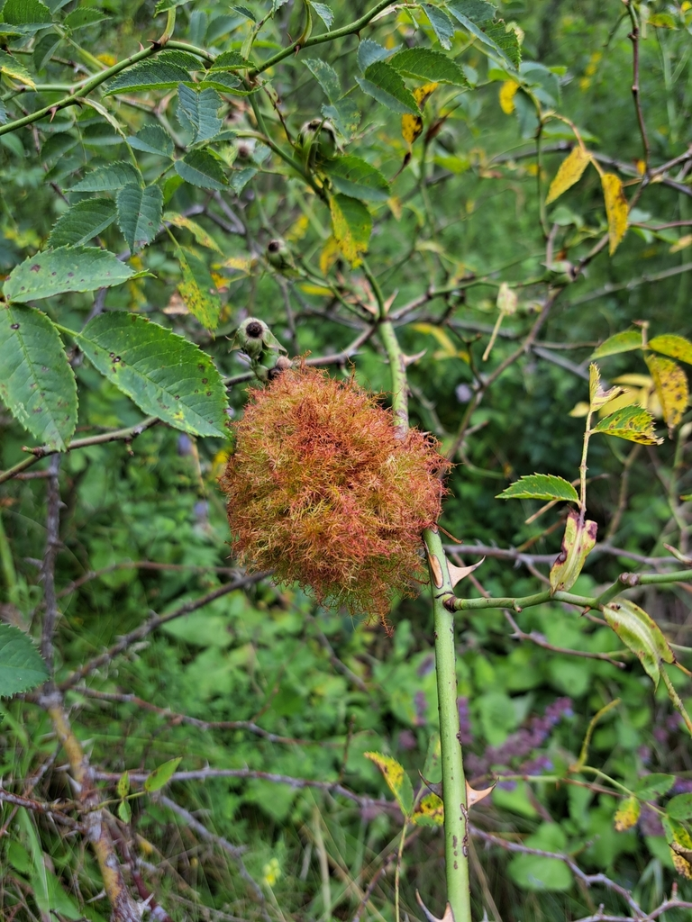
8.
iNat
iNot

Slide 17
8.
iNat
It is a gall (a shelter created by a parasite on a plant for its larvae) of the Mossy Rose Gall Wasp, our common hymenopteran, so it belongs on iNaturalist.

Slide 18
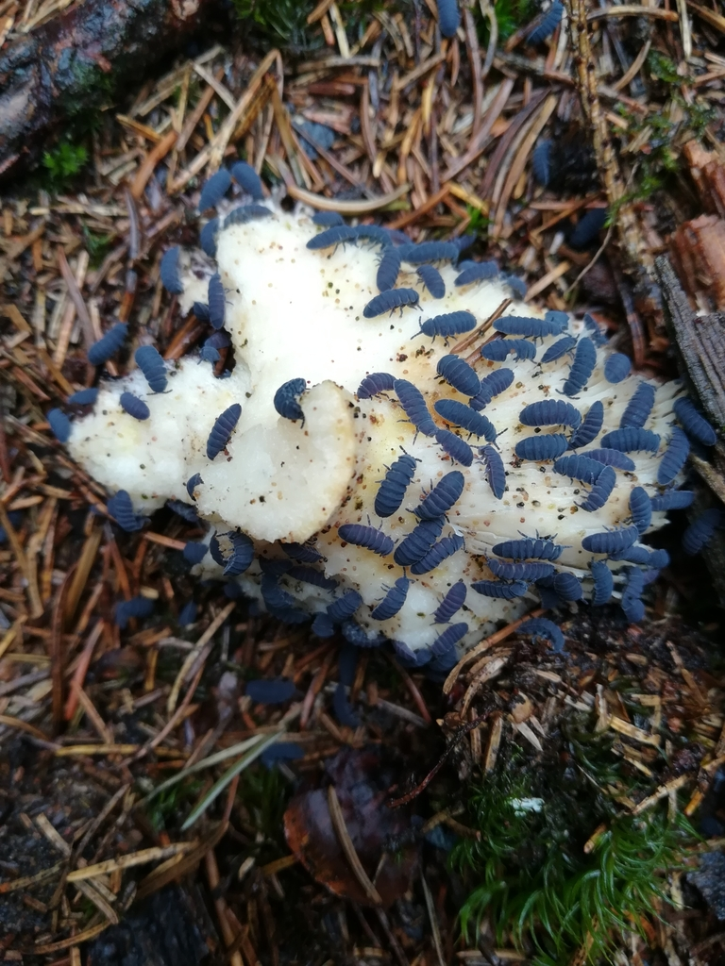
9.
iNat
iNot

Slide 19
9.
iNat
It is our largest European springtail, the Tetrodontophora bielanensis, so it belongs on iNaturalist. It is important to photograph it close-up and focus well.

Slide 20
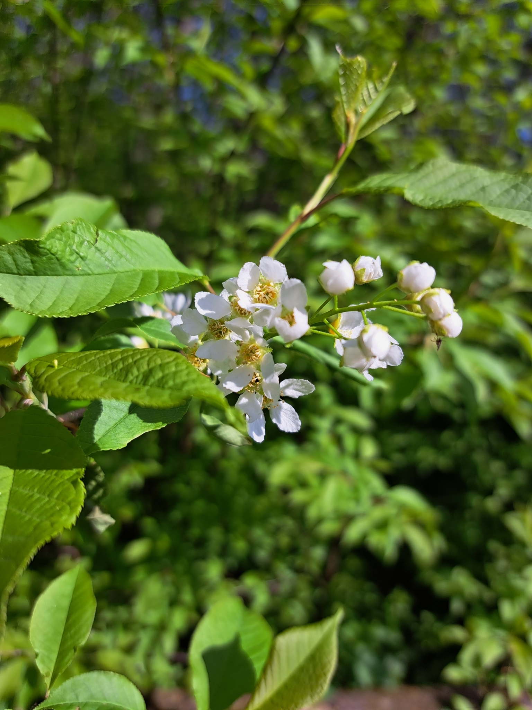
10.
iNat
iNot

Slide 21
10.
iNat
It is our native wild cherry, European Bird Cherry, growing in the wild, so it belongs on iNaturalist.

Slide 22
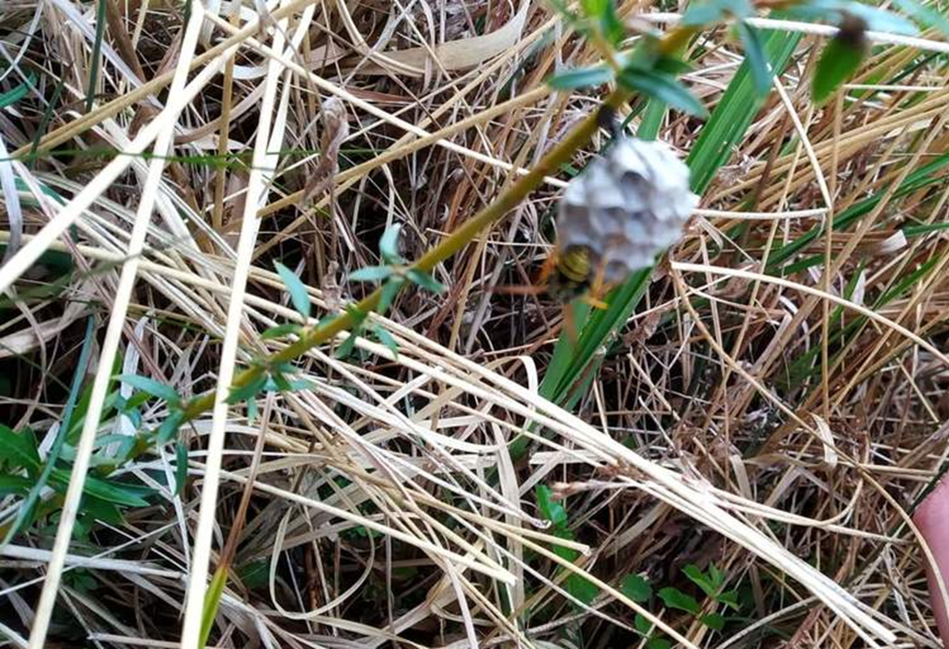
11.
iNat
iNot

Slide 23
11.
iNot
Unfocused photos are usually unidentifiable, so they don‘t belong on iNaturalist.

Slide 24
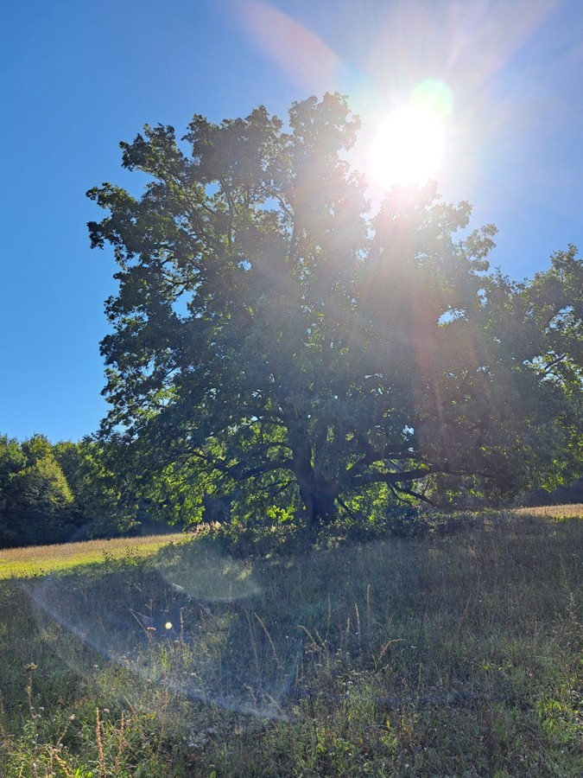
12.
iNat
iNot

Slide 25
12.
iNot
The photo is overexposed and taken from such a distance that the tree cannot be identified, so it doesn‘t belong on iNaturalist.

Slide 26
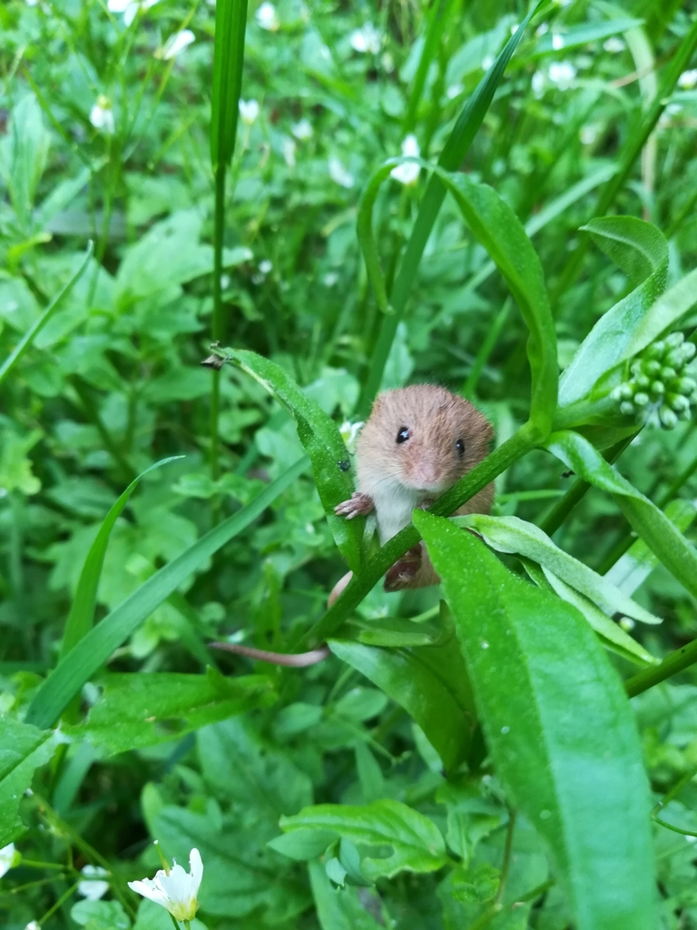
13.
iNat
iNot

Slide 27
13.
iNat
It is the smallest wild European rodent, the Harvest Mouse, so it belongs on iNaturalist.

Slide 28
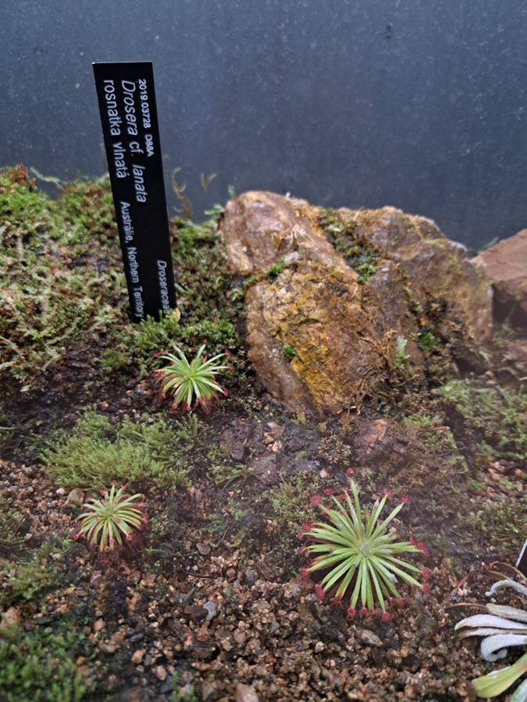
14.
iNat
iNot

Slide 29
14.
iNot
It is a cultivated plant from a botanical garden, so it doesn‘t belong on iNaturalist.

Slide 30
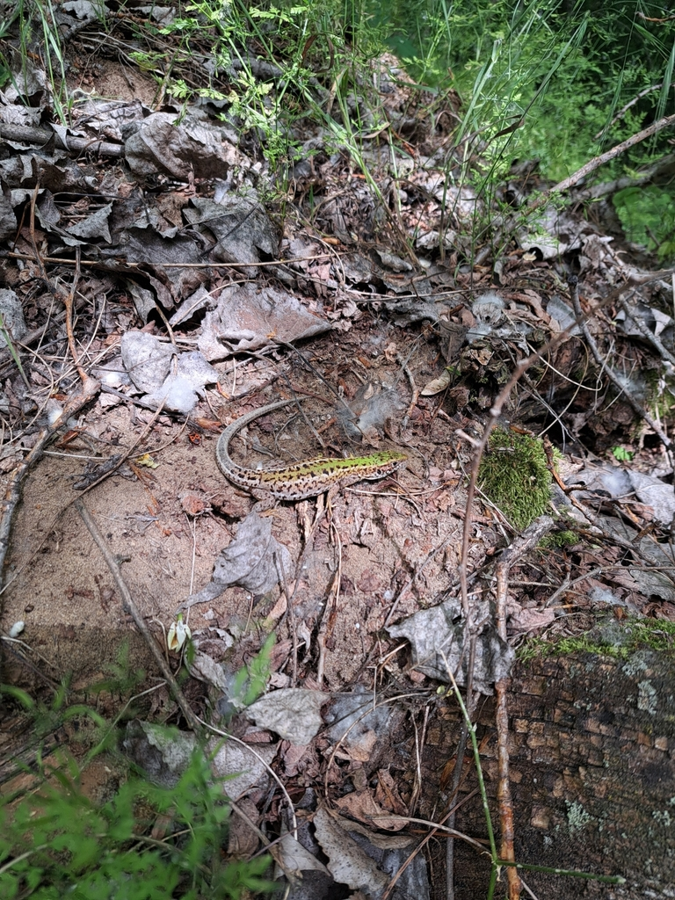
15.
iNat
iNot

Slide 31
15.
iNat
It is a wild Green Lizard, so it belongs on iNaturalist.

Slide 32
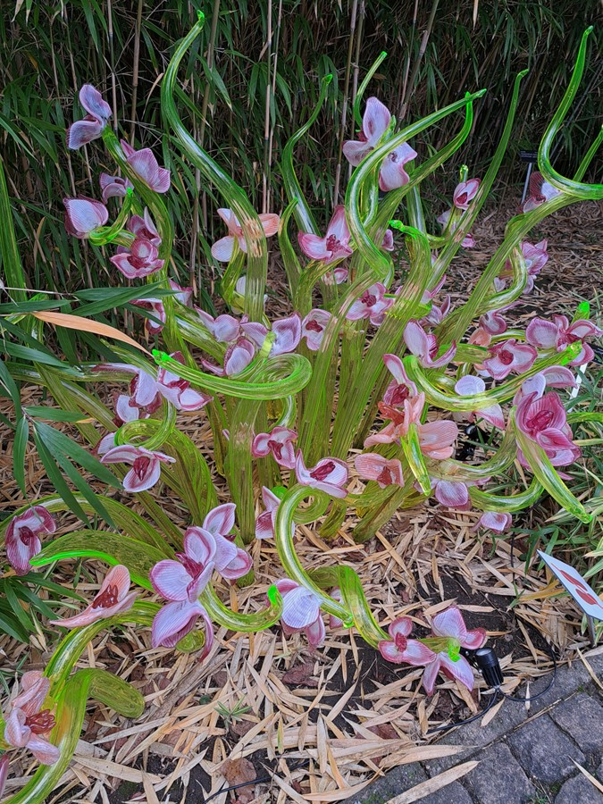
16.
iNat
iNot

Slide 33
16.
iNot
Fake plants, plush toys, or any other replicas of living organisms don‘t belong on iNaturalist.

Slide 34
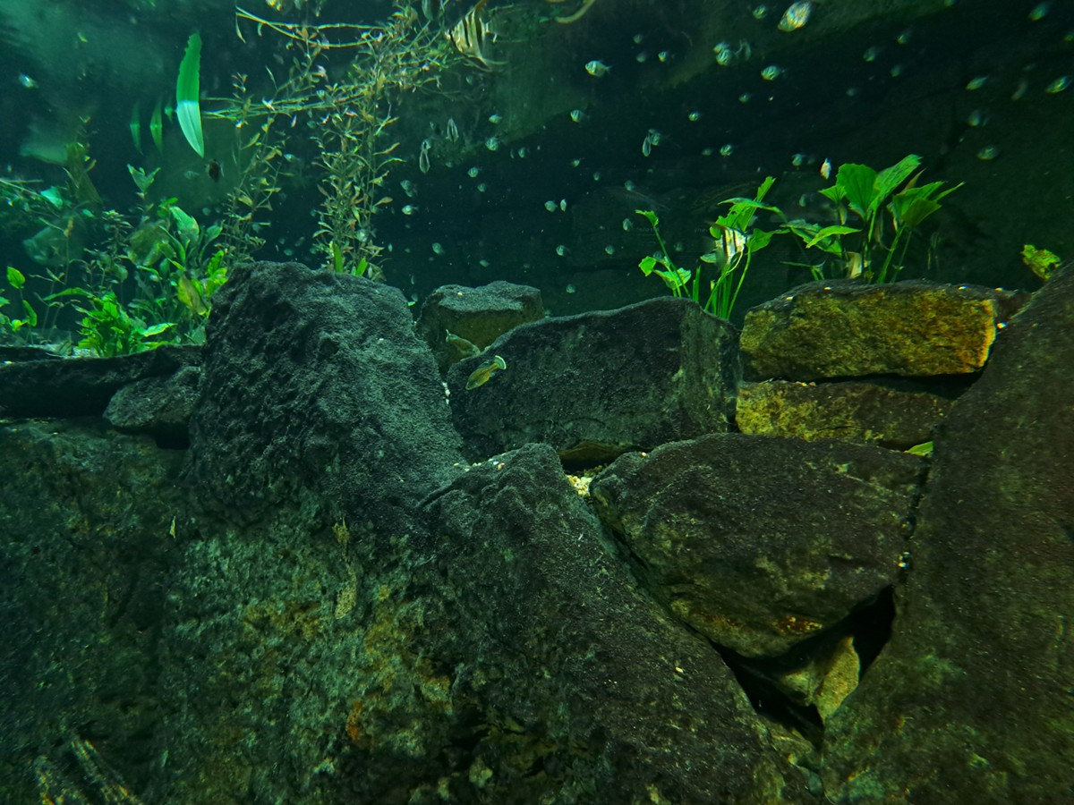
17.
iNat
iNot

Slide 35
17.
iNot
It is a photo from an aquarium, so it doesn‘t belong on iNaturalist.

Slide 36
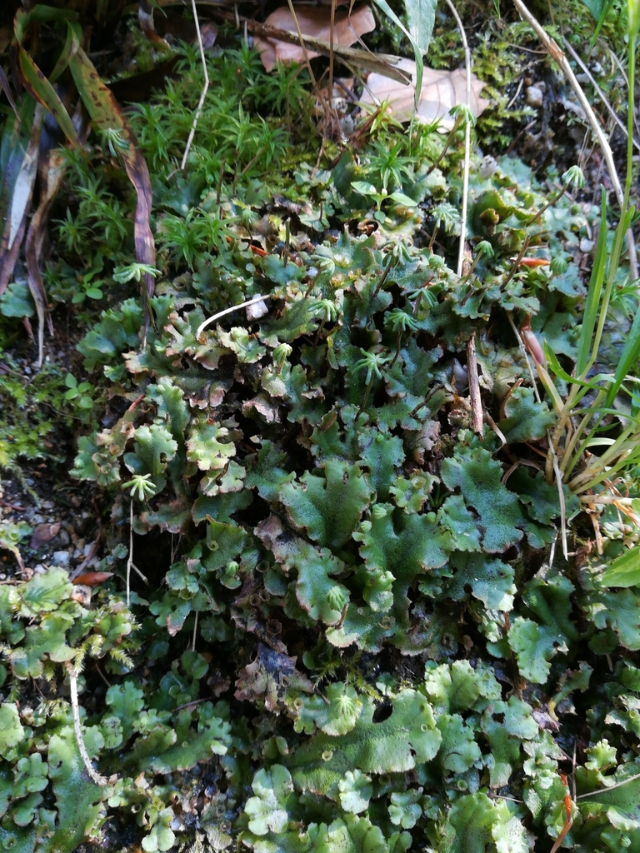
18.
iNat
iNot

Slide 37
18.
iNat
It is a common liverwort, the Umbrella Liverwort, so it belongs on iNaturalist.

Slide 38
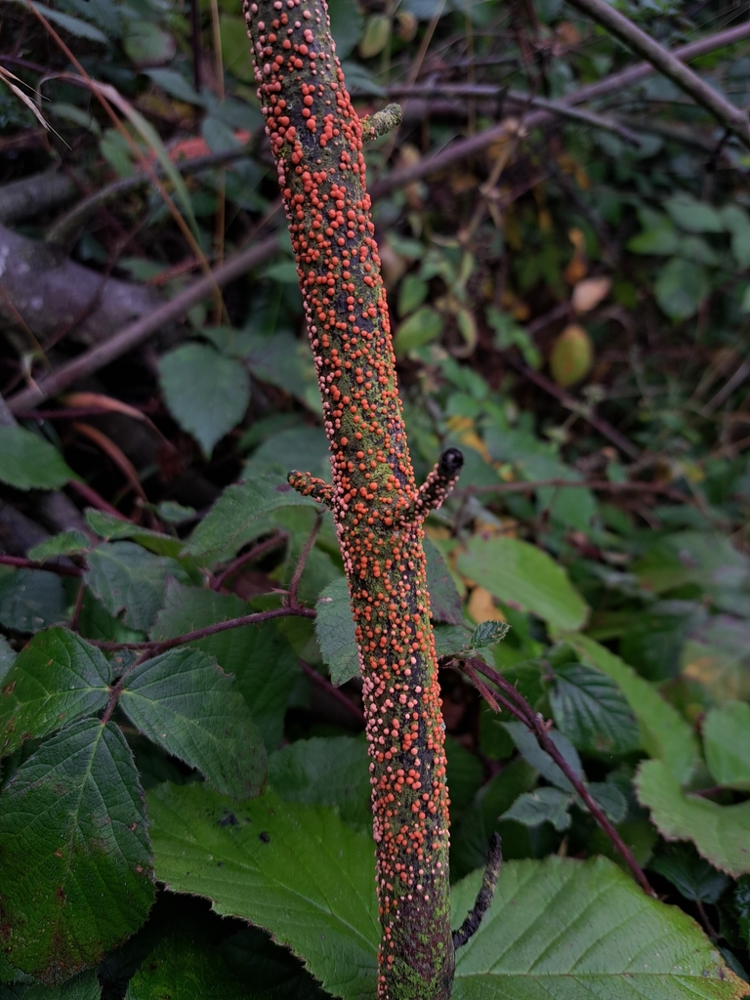
19.
iNat
iNot

Slide 39
19.
iNat
It is a common ascomycete fungi, the Coral Spot, so it belongs on iNaturalist.

Slide 40
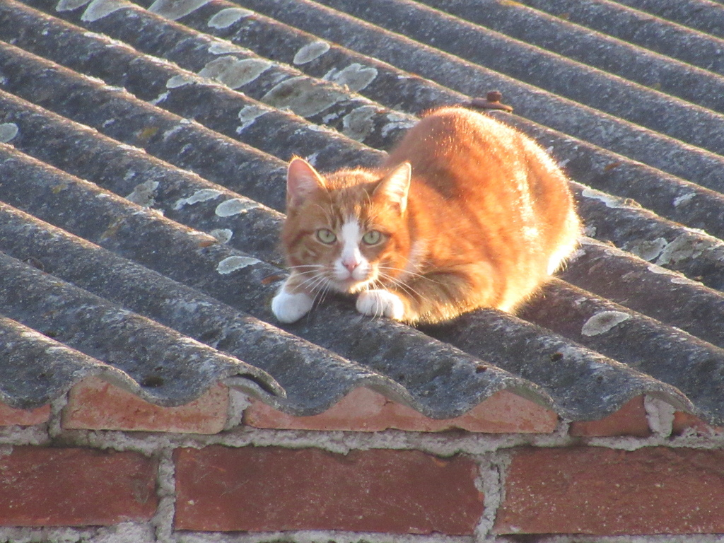
20.
iNat
iNot

Slide 41
20.
iNot
It is a domestic cat, and no pets belong on iNaturalist.

Slide 42
And now let‘s go out and explore!
24. 4.–27. 4. 2026 we are excited to see your observations

